Slide 1

NFL Database Application
Vishnu Bondalakunta
Charles Zumbaugh
James Chapman
Flickr: Barry Schwartz

Slide 2
Overview
Introduction
Demonstration
Discussion

Slide 3
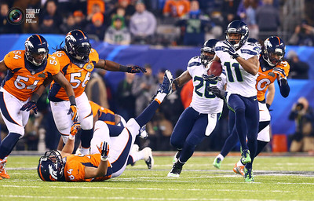
National Football League (NFL)
NFL is a professional American football league
32 teams compete in the NFL
Super Bowl is annual league championship game
Flickr: Molto Torres

Slide 4
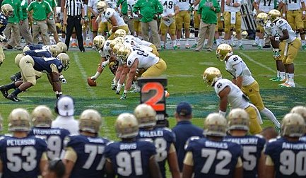
American Football Rules
Games last for 4 quarters of 15 minutes each.
Each team has 4 downs(attempts) to gain 10 or more yards.
Yards are gained by running with ball or passing it to receiver
Down marker showing 2nd down.
Source: US Navy

Slide 5
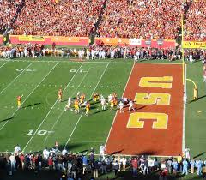
American Football Rules
A play is a plan or strategy used to move the ball down the field.
Pass: Ball thrown by a player
Rush: Running with the ball
Touchdown: Advancing ball to opponent end zone. Worth 6 points
Source: End Zone - Wikipedia

Slide 6
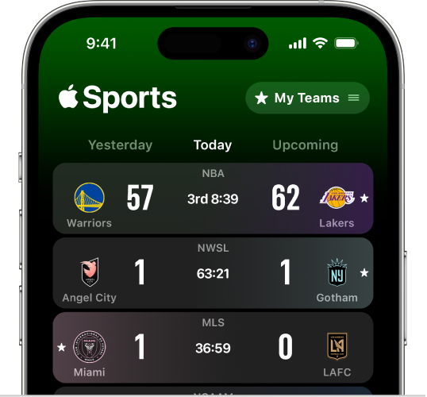
NFL Sports App
Objective: Obtain stats from the NFL games.
Targeted users: Football fans, statisticians.
Possible Applications
Fantasy Football
Sports Betting
Casual information
Source: https://support.apple.com/en-tm/guide/apple-sports-app/apdec6a74b4c/web

Slide 7
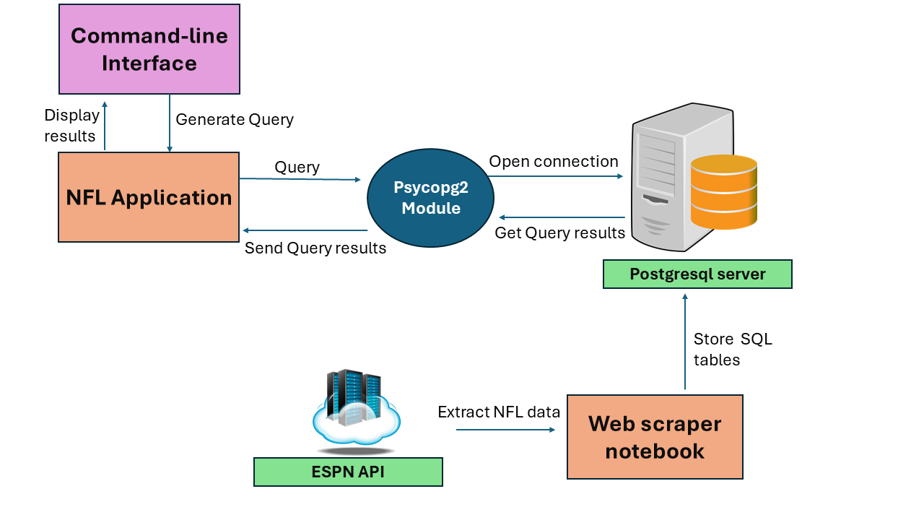
NFL database system implementation
Python application
Extract past 10 years of NFL data from ESPN API

Slide 8
Schema - 11 tables
Teams (team_name, location, abbreviation, venue_name, primary_color, secondary_color)
Venues (venue_name, capacity, city, state, grass, indoor)
Games (game_id, date, attendance, home_team_name, away_team_name, venue_name, utc_time)
Season_dates (date, season_year, season_type, week)
Athletes (athlete_id, first_name, last_name, dob, height, weight, birth_city, birth_state)
Positions (position_name, abbreviation, platoon)
Rosters (team_name, athlete_id, position_name, start_date, end_date)
Linescores (team_name, game_id, quarter, score)
Plays (play_id, quarter, yards, score_value, play_type, text, seconds_remaining, start_down, end_down)
Player_Plays (play_id, player_id, game_id, type)
Users (uid, username, password, first_name, last_name, created_on, fav_team_name, fav_athlete_id)

Slide 9
NFL Application Installation
NFL application publicly available at GitHub
https://github.com/JamesChapmanNV/NFL_database
Read the documentation for installation

Slide 10
NFL Application Walkthrough
Demonstrate the NFL application

